Slide 1
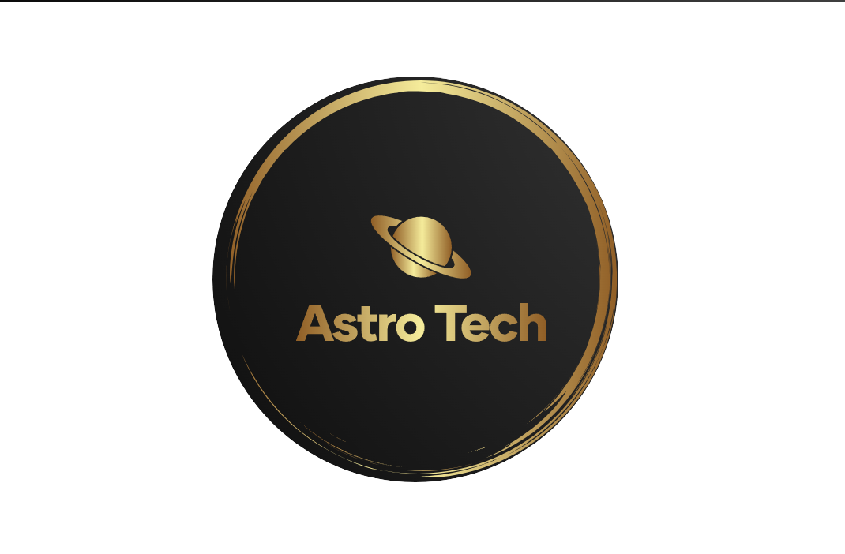
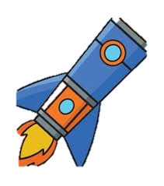
ASTRO TECH
Team Members:
1-leader: Mohamed AbdElkadir Mohamed
2- Researcher: Mohamed Elsayed Mohamed
3- Web development: Karim Mohamed Nady’
4- Researcher: Yassin Eslam Ibrahim

Slide 2
Our team “Astro Tech” is working on a project that will help a lot of people by illustrating them to the space technology and telescopes.
Our plan to help people is making a website on the internet and we will provide an illustrative video that will show the importance of the JWST.

Slide 3
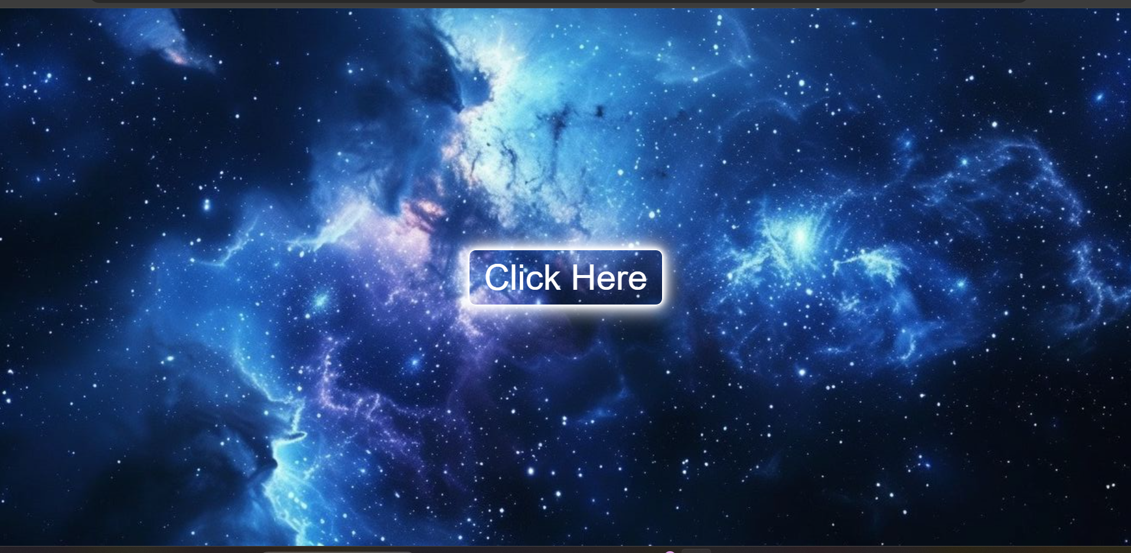
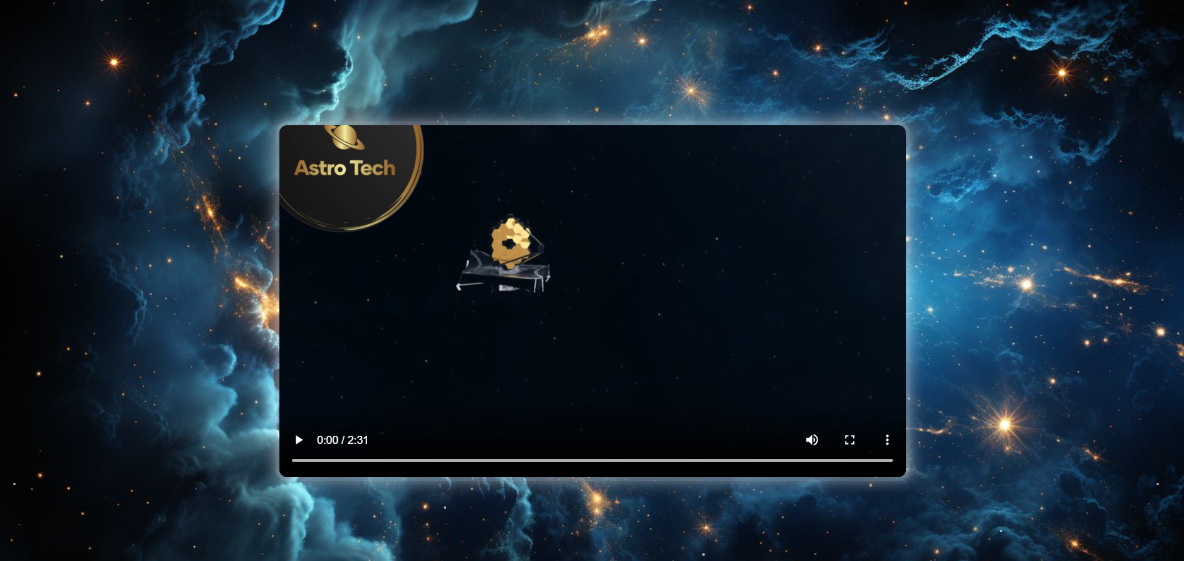
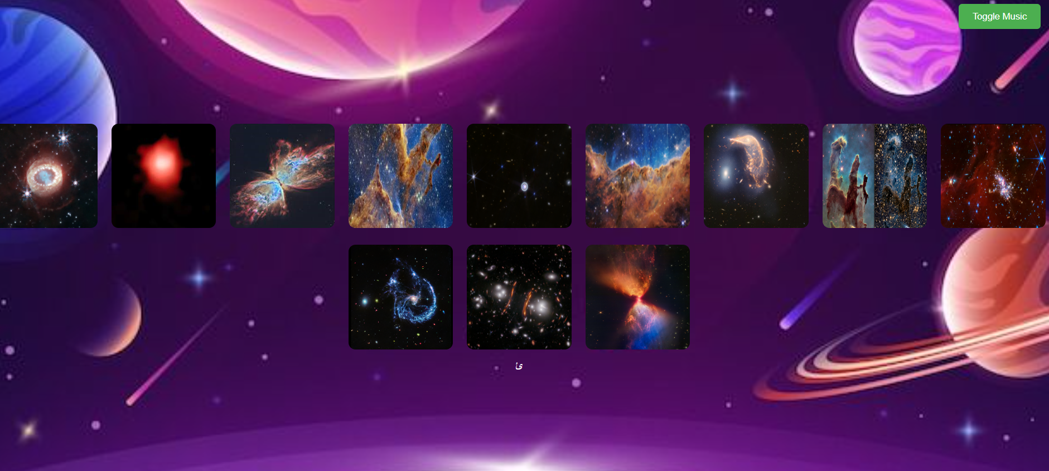
Our video and website will be made by a way that can attract the audience due to: - The easy explanation - The beautiful images that was captured by JWST - The easy usage of the website - Some articles about some cosmic phenomena
Our Website

Slide 4
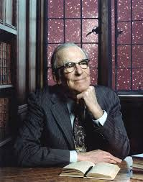
Let’s go back to (1940s):
Lyman Spitzer was an American theoretical physicist, he was the first one to present the idea of space telescope
Lyman Spitzer

Slide 5
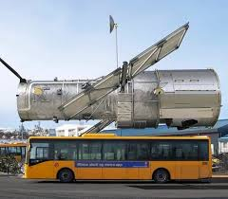
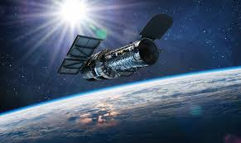
The First Space Telescope (HUBBLE Telescope) 1990:
And in 24th April 1990, a great science invention, an invention that opened the universe in front of us, They Launched The First Space Telescope “HUBBLE Telescope”.
The Hubble Space Telescope orbits just above Earth's atmosphere at an altitude of approximately 320 miles (515 km).
This telescope captured images from distant galaxies, nebulas, …… Etc., and so many other benefits.

Slide 6
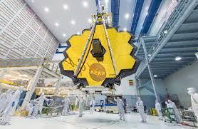
New one, New start (1996-2021):
In 1996, scientists started working on a new telescope, a new one but better.
Yes, It’s JAMES WEBB SPACE TELESCOPE
The scientists developed the Hubble and worked on it to give us a new developed and more powerful telescope.
And in December 2021 the historic day, the scientist launched the James Webb space telescope.

Slide 7
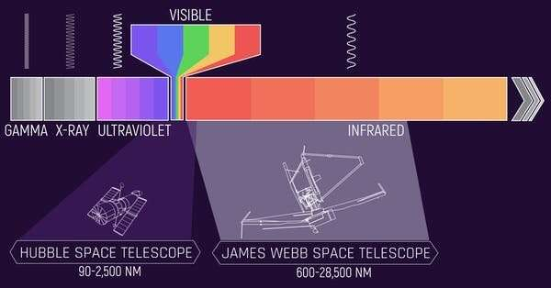
Here are you the electromagnetic spectrum of both JWST and Hubble telescope:

